Slide 1
17. Hand Helicopter
František Kundracik
Department of Experimental Physics
Faculty of Mathematics, Physics and Informatics
Comenius University, Bratislava, Slovakia

Slide 2
17. Hand Helicopter
A simple hand helicopter can be made by attaching rotor blades to one end of a vertical stick. The helicopter moves upwards when the stick is twisted at a high enough speed and then let go. Investigate how the relevant parameters affect the lift-off and the maximum height.

Slide 3
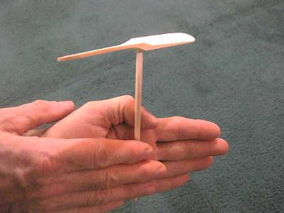
17. Hand Helicopter
A simple hand helicopter can be made by attaching rotor blades to one end of a vertical stick. The helicopter moves upwards when the stick is twisted at a high enough speed and then let go. Investigate how the relevant parameters affect the lift-off and the maximum height.

Slide 4
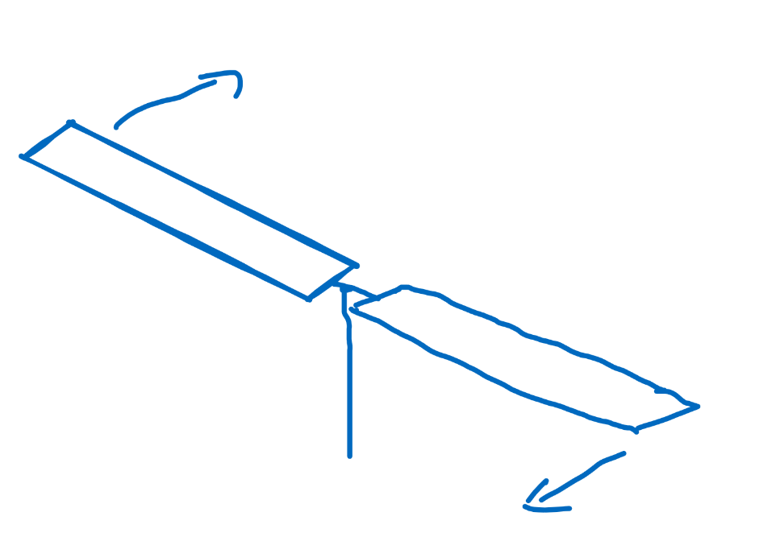
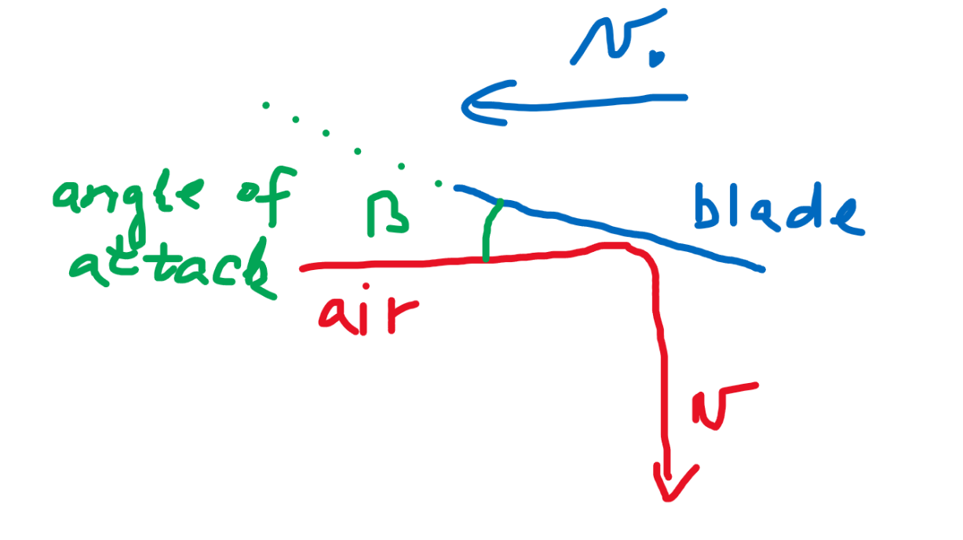

Thrust force
Air is pushed down due to angle of attack β
Air vertical velocity – estimated as lossless rebound of a ball
$$v≈v_{0}sin2β$$

Slide 5
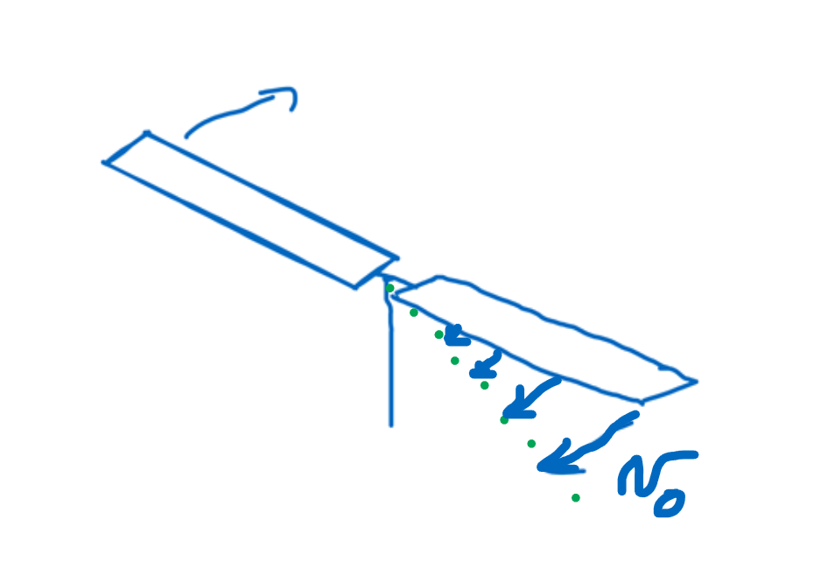
Thrust force
Attention!
  Velocity of the blade changes along the blade! An effective velocity (smaller than the velocity of the end of the blade) has to be used!
  The effective force acting on the air depends also on the number of blades and their area!
  Air is a continuos media, so some
  free space between the blades is
  acceptable, but you have to increase
  the number of blades, if they are thin!

Slide 6
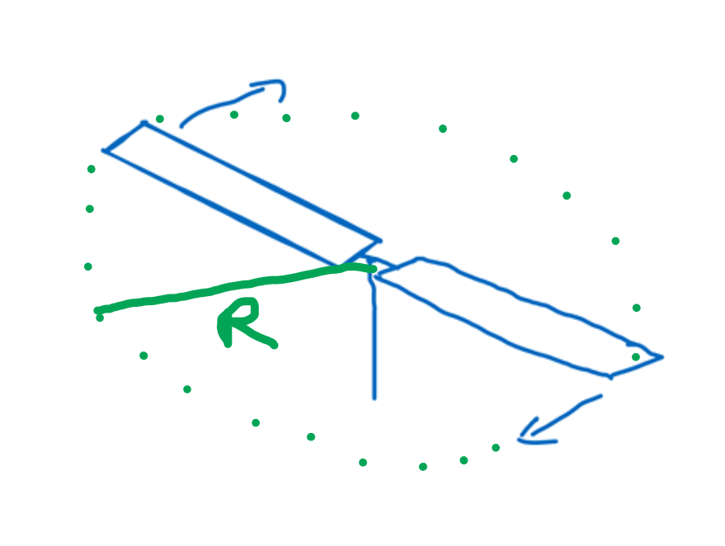


Thrust force
Volumetric flow of the air (litres per second) is:
S - circular area covered by rotating blades
R – length of the blades
$$\frac{V}{t}=vS$$
$$S=πR^{2}$$

Slide 7

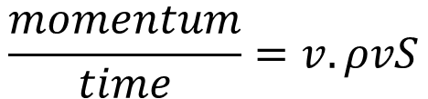
Thrust force
mass flow of the air (kilograms per second) is:
ρ – density of the air
This air must get the momentum
$$\frac{m_{air}}{t}=ρvS$$
$$\frac{momentum}{time}=v.ρvS$$

Slide 8


Thrust force
The force acting on the air is the same as the lift-force acting on the blades
The lift-force is usually expressed in the form
C_{L} – dimensionless constant, 0 < C_{L} < 1
f – rotational frequency of the blades in Hz
$$F_{L}≈ρv^{2}S$$
$$F_{L}=C_{L}\frac{1}{2}ρv^{2}S$$
$F_{L}=C_{L}\frac{1}{2}ρSv_{0}^{2}.\sin^{2}2β$=$C_{L}\frac{1}{2}\left(πR^{2}\right){{\left(2πRf\right)}^{2}sin}^{2}2β$

Slide 9
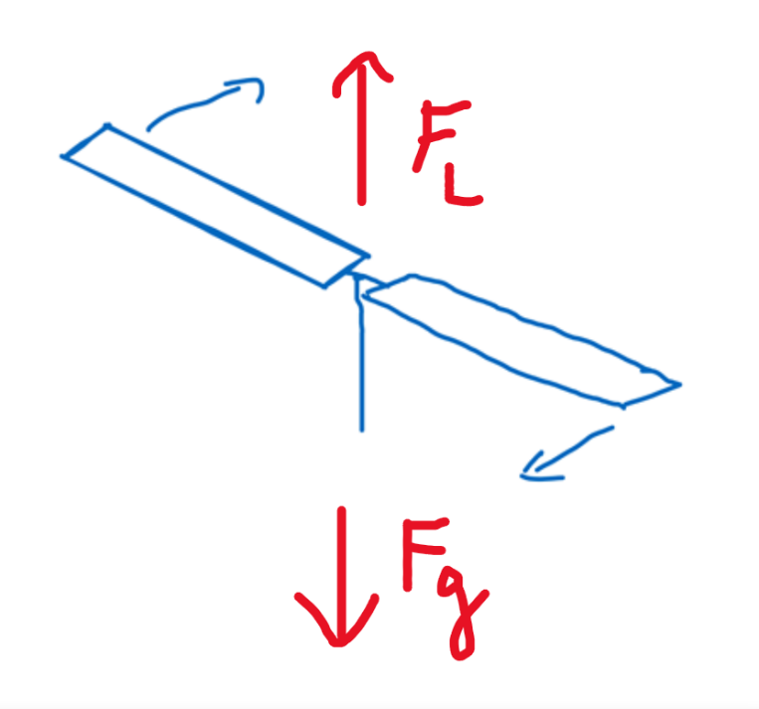
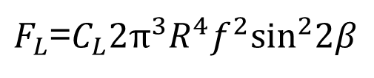
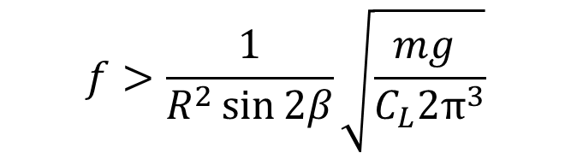

Thrust force
Finally
The lift-force shoud overcome the
gravitational force acting on the
whole mechanism
m - mass of the toy, g – gravitational acceleration
$F_{L}$=$C_{L}2π^{3}R^{4}f^{2}\sin^{2}2β$
$$F_{L}>mg$$
$$f>\frac{1}{R^{2}\sin{2β}}\sqrt{\frac{mg }{C_{L}2π^{3}}}$$

Slide 10
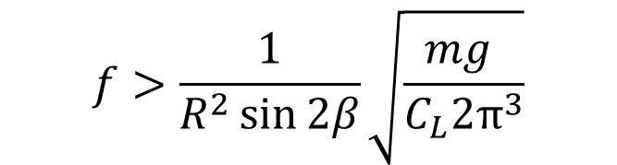

Lift-up condition
$$f>\frac{1}{R^{2}\sin{2β}}\sqrt{\frac{mg }{C_{L}2π^{3}}}$$
The nominator should be as low as possible
  Low mass m of the toy
The denominator should be as big as possible
  Optimal angle of the attack is ca 45º
  Scaling the toy is not so much effective (mass ~ R³)
$$f_{min}\sim \frac{\sqrt{R^{3}}}{R^{2}}=\frac{1}{\sqrt{R}}$$

Slide 11
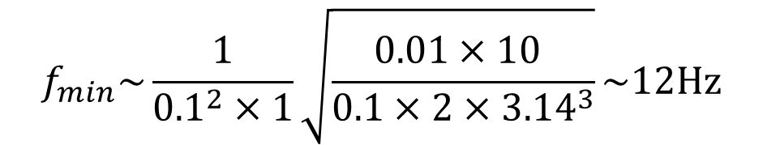
Lift-up condition
Estimation of the minimum frequency:
  R=0.01m (blades 10 cm)
  m=0.01kg
  C_{L}=0.2
A realistic result, C_{L} was only estimated, no idea about its real value
$$f_{min}\sim \frac{1}{{0.1}^{2}×1}\sqrt{\frac{0.01×10 }{0.1×2{×3.14}^{3}}}\sim 12Hz$$

Slide 12


Flight time/height
The toy will fly up until the rotational frequency is high enough (the lift-up condition must be met)
The rotation is slowed down due to
  Accelerating the air – usually the main effect
  Drag force acting against the moving blades – can be dominant at high angles of attack – optimal angle of the attack should be less than 45 degrees, perhaps 10-30 degrees?
Power needed for the acceleration of the air (in watts)
$${P=F}_{L}v=C_{L}\frac{1}{2}ρv^{2}S.v=C_{L}\frac{1}{2}ρv^{3}S$$
$P=4C_{L}π^{4}R^{5}f^{3}\sin^{3}$ $2β$

Slide 13
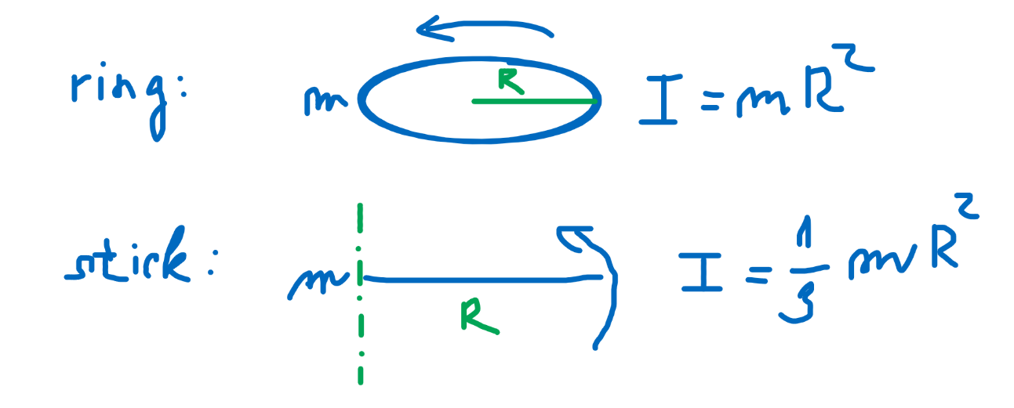


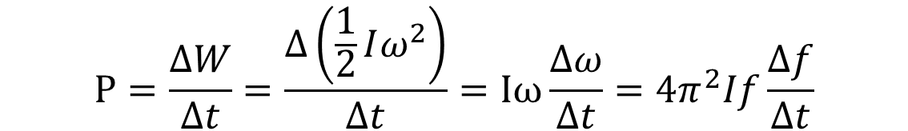
Flight time/height
The power needed comes from the rotational energy of the toy
The rotation is slowing down due to power given to the air
I – moment of inertia
Generally:
  C_{L} – constant 0 < C_{L} < 1
$$W=\frac{1}{2}Iω^{2}=2π^{2}If^{2}$$
$$P=\frac{∆W}{∆t}=\frac{∆\left(\frac{1}{2}Iω^{2}\right)}{∆t}=Iω\frac{∆ω}{∆t}=4π^{2}If\frac{∆f}{∆t}$$
$$I=C_{I}mR^{2}$$

Slide 14


Flight time/height
How long takes the slowing down?
What can we see:
  Scaling is not very effective, m~R³,
  Δt doesn‘t depend on R
Estimated time of flight
C_{L}=0.5
Δf=0.5f (toy gets 50% more rotation at the begin than is the minimal one)
Δt = 3s
$$∆t=4π^{2}If\frac{∆f}{P}$$
$$∆t=\frac{C_{I}m∆f}{C_{L}π^{2}R^{3}f^{2}\sin^{3} 2β }$$

Slide 15
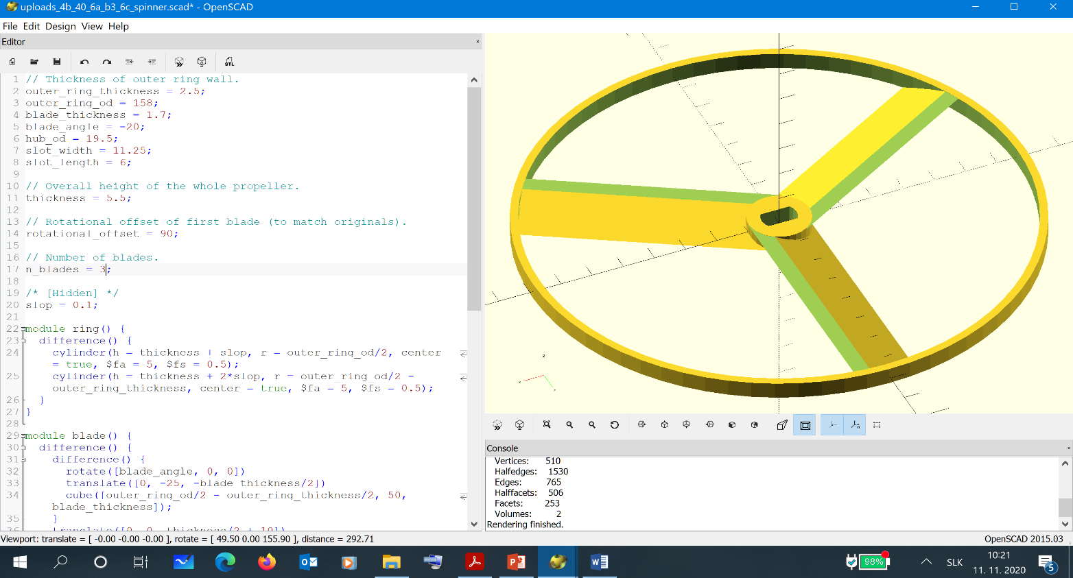
What to do?
  Prepare a set of toys – various parameters
  3D printing is a good possibility
  https://www.thingiverse.com/thing:291404
    A simple customizable SCAD model, good starting point to own design

Slide 16
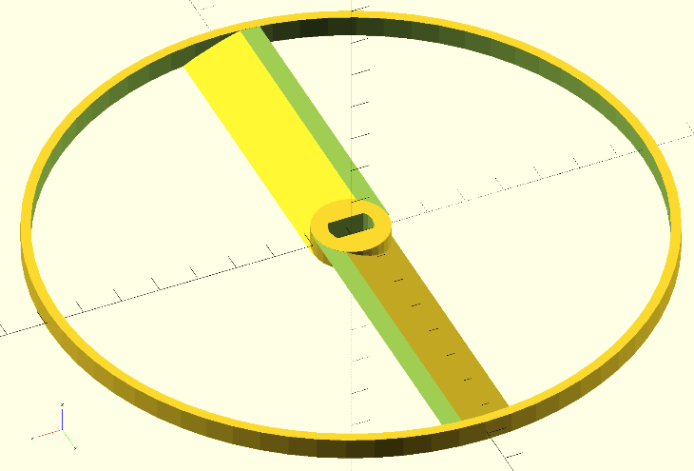
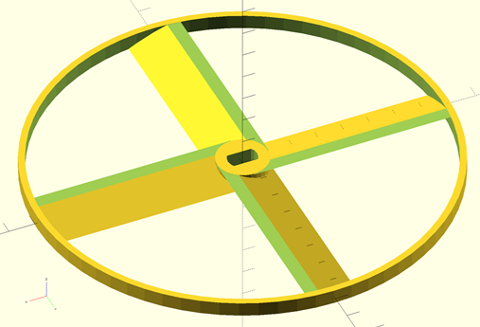
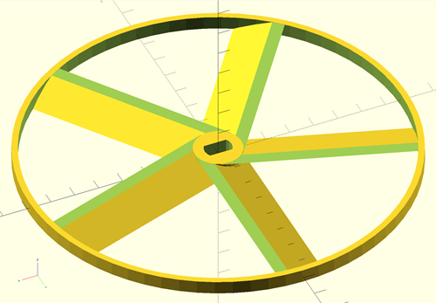
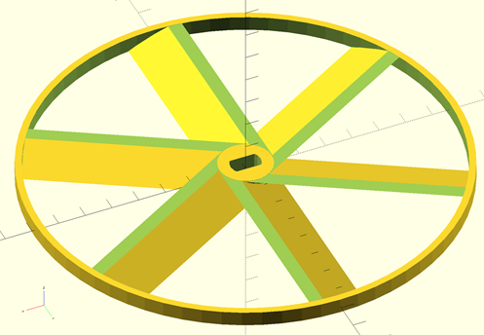
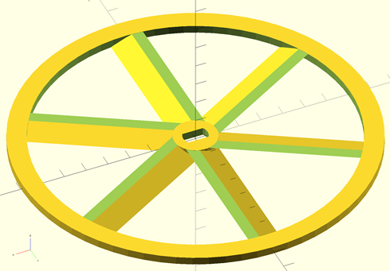
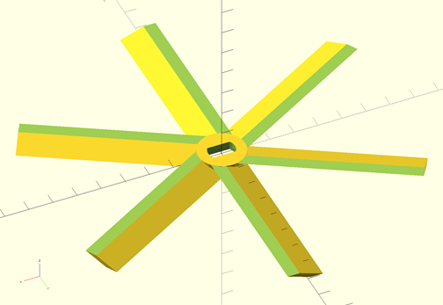
What to do?
  You can easily change: number of blades, width of blades, angle of attack, mass of the ring, scaling, ...

Slide 17
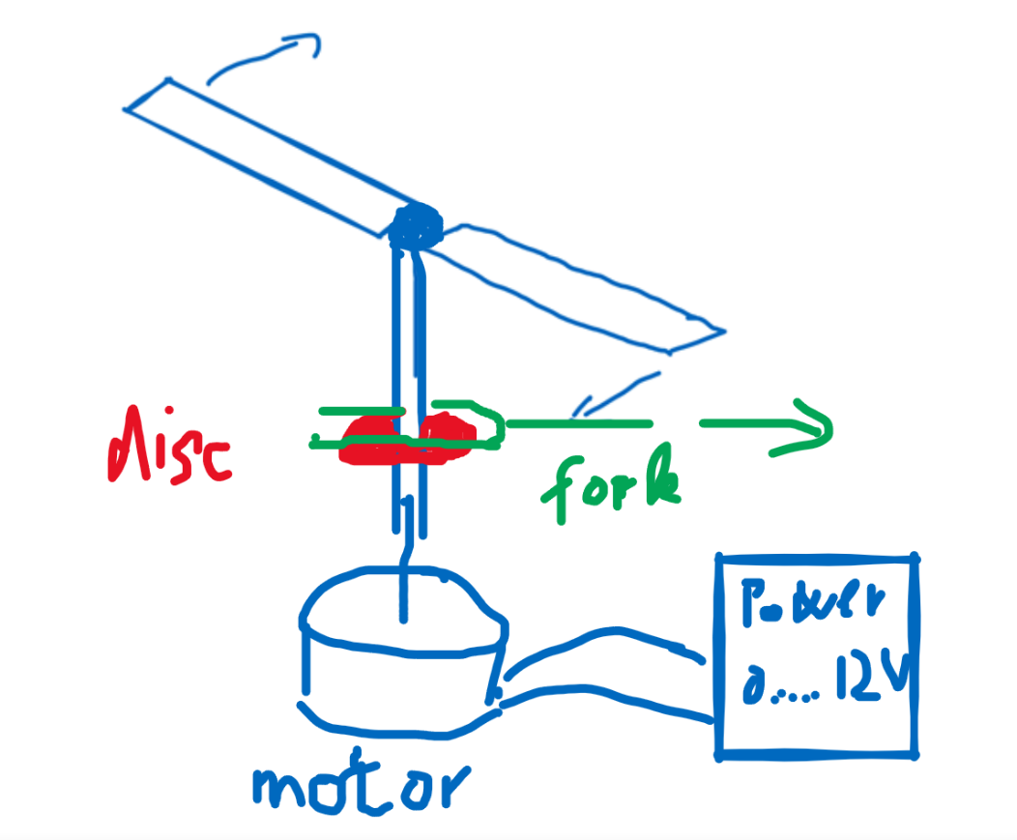
What to do?
  Build a motor driven starting device
  Frequency controlled by voltage source
  Frequency measured by a LED-stroboscope, for example,
  search Google Play for App
  like „Strobily“
  Releasing – remove the fork

Slide 18
What to do?
  Measure the lift-force using kitchen weights, for example
  Compare the lift-up force with the theory

Slide 19
What to do?
  Measure the slow-down of the rotation
  Optimize the toy for maximum lift-force and minimum slow-down
  Measure the flight-high for various designs, find maximum
  Critically compare results with the theory – the theory is simplified, lift-up coefficient and/or drag coefficient can depend on the frequency, for example (they were epected to be constants)

Slide 20
Literature
  http://sphsdevilphysics.weebly.com/uploads/5/0/7/1/5071691/example02_en.pdf
  https://www.coloradocollege.edu/academics/dept/physics/images/posters_18_19/Harm_Poster.pdf
  https://www.intechopen.com/books/flight-physics-models-techniques-and-technologies/helicopter-flight-physics
  And many others...
  Thank you for your attention

